Slide 1
Visual Inertial Odometry Datenfusion

Slide 2
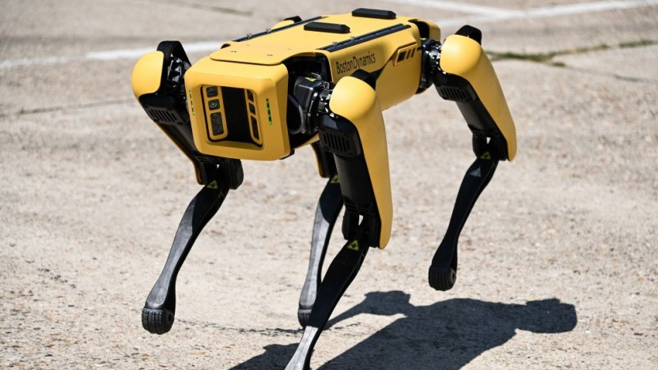
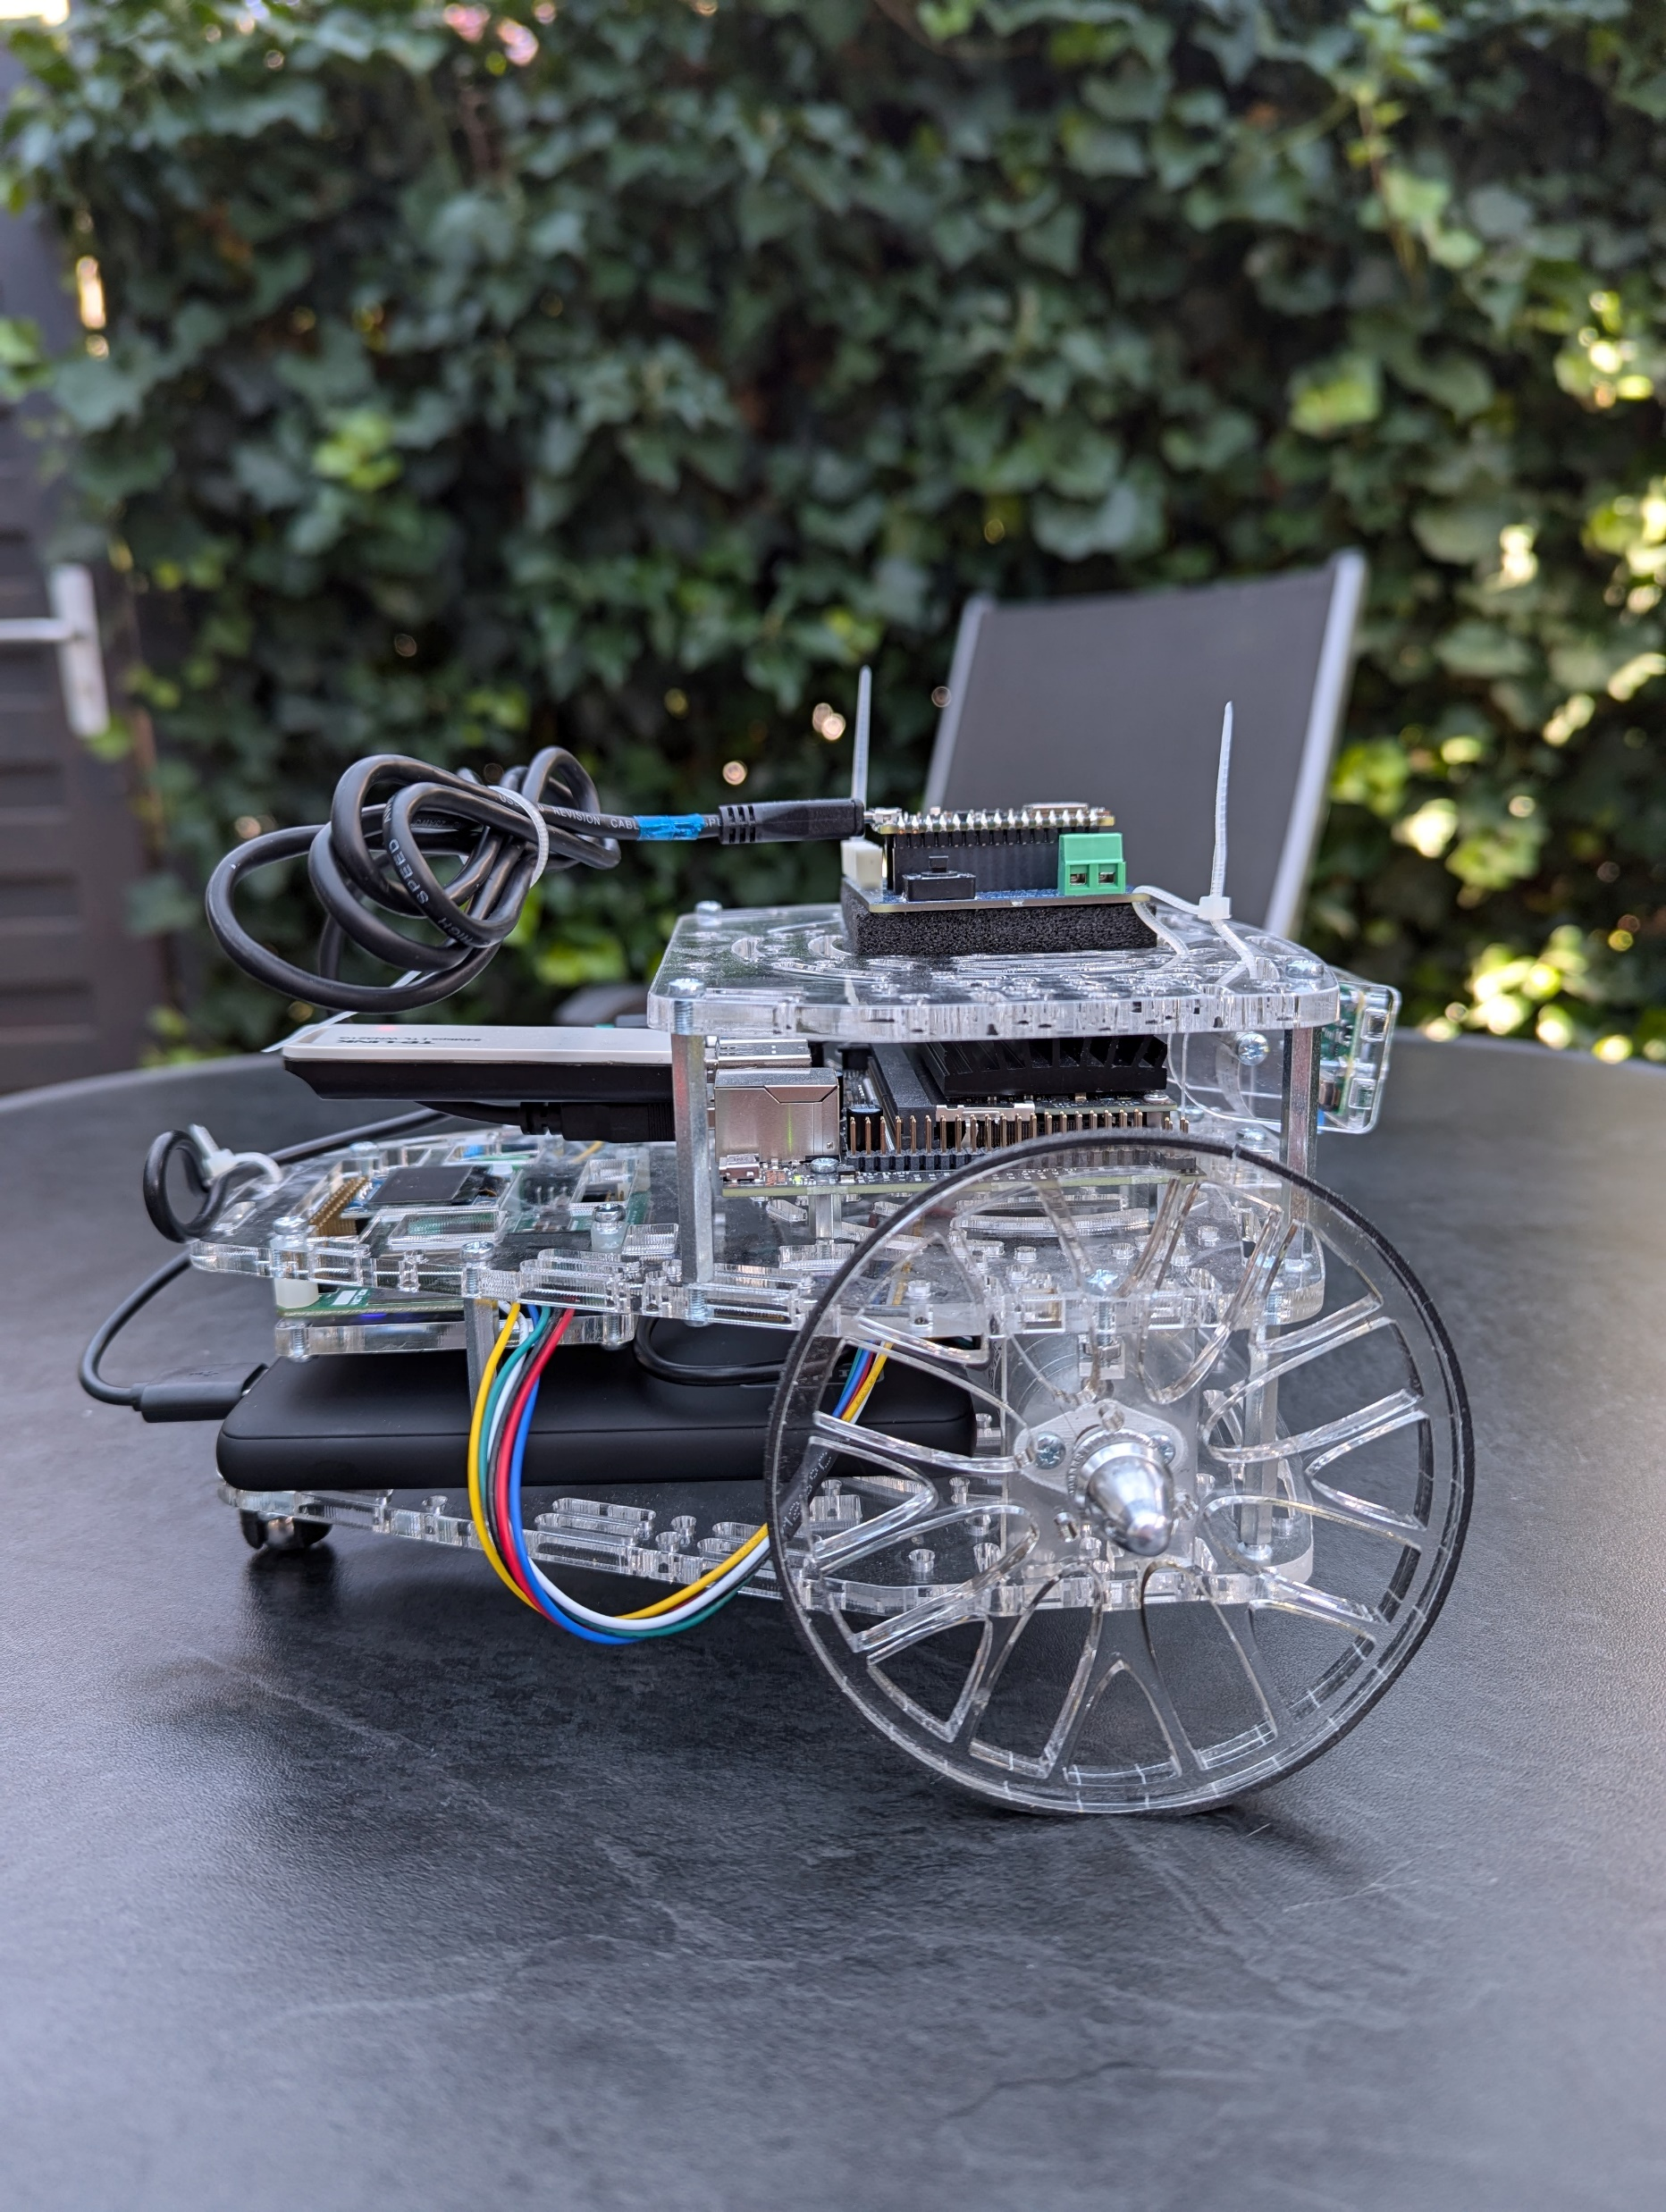
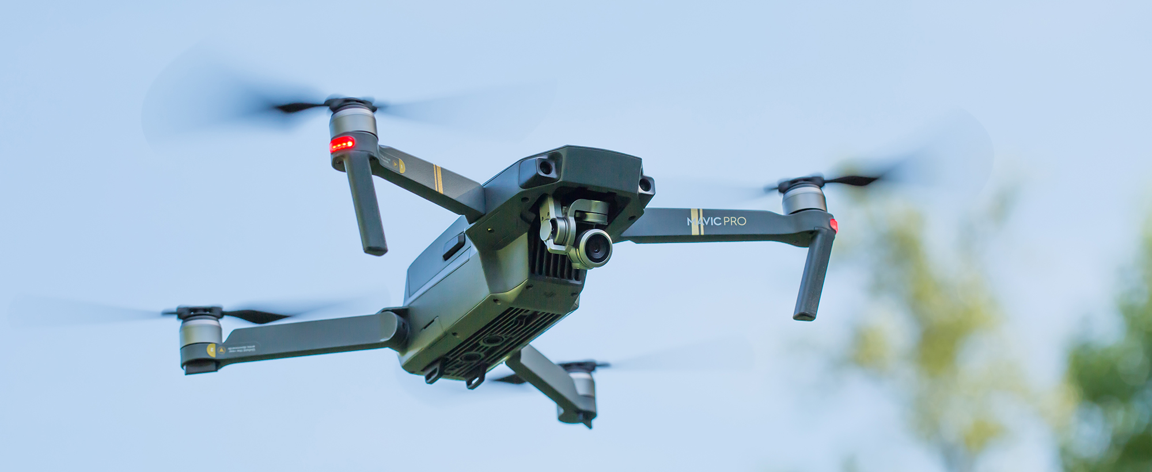
Warum VIO?

Slide 3
Puzzlebot Setup

Slide 4
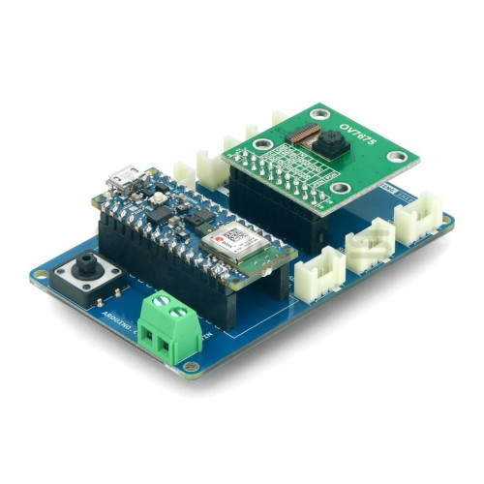
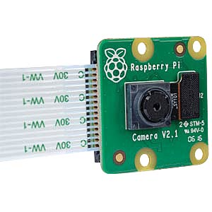
Sensorik
IMU
TinyML-Kit
Kamera
Raspi Cam v2

Slide 5
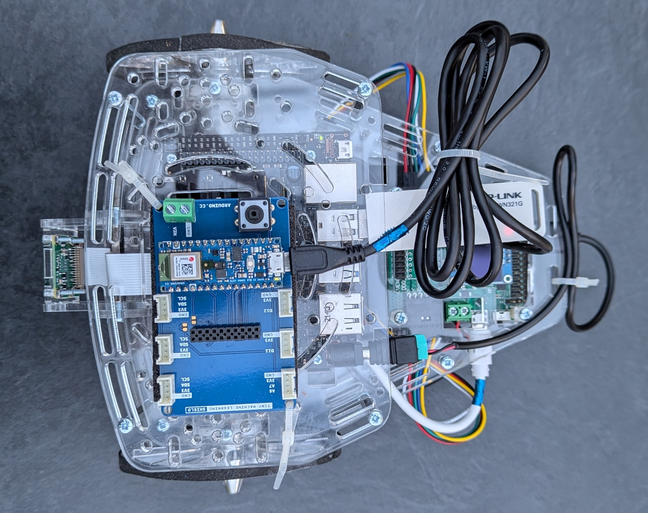

Slide 6
Visual Odometry

Slide 7
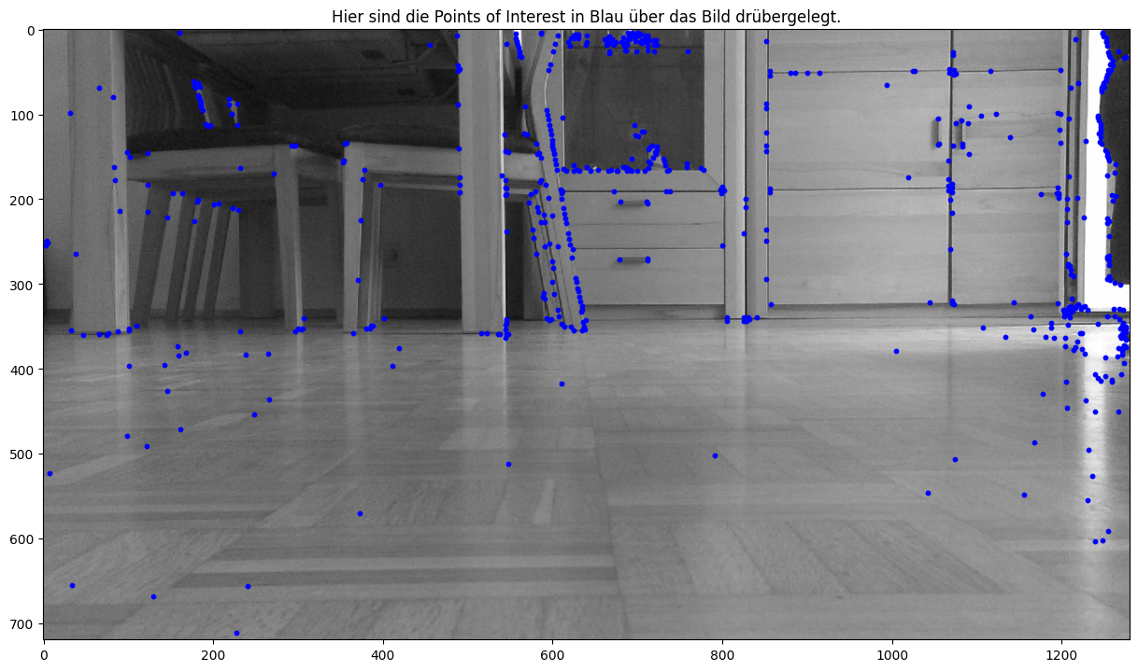
Feature Detection

Slide 8
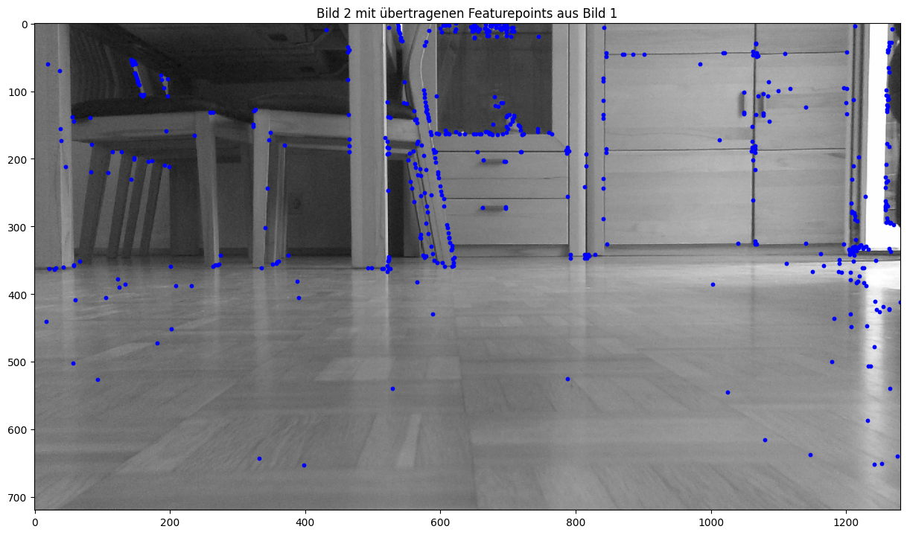
Feature Tracking
(Gleiche Punkte, späteres Bild)

Slide 9
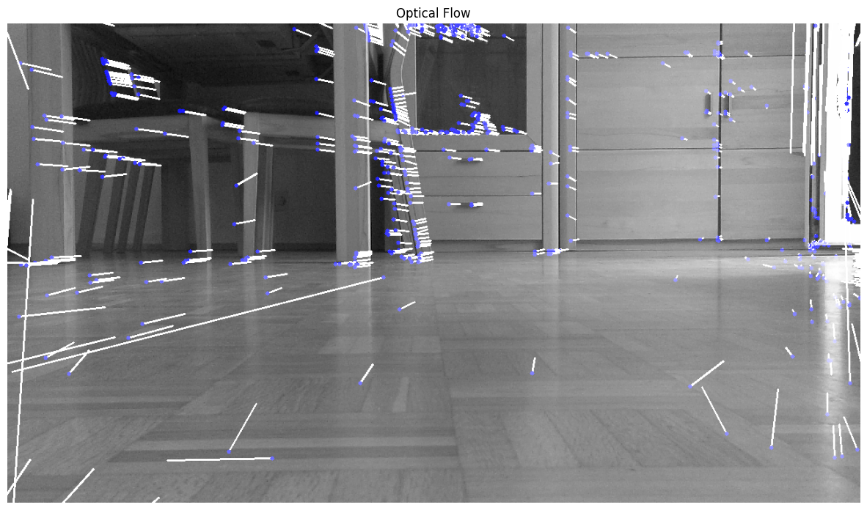
Optical Flow

Slide 10
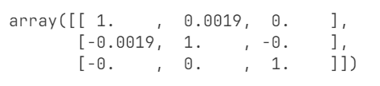
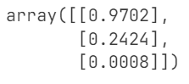
Visual Odometry Outputs
Rotationsmatrix
Richtungsvektor
x
Positionsupdate

Slide 11
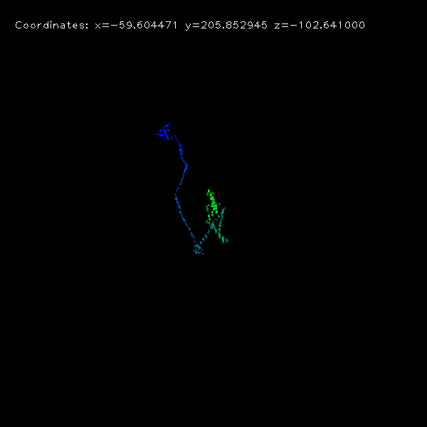
Anwendung Puzzlebot

Slide 12
IMU Data

Slide 13
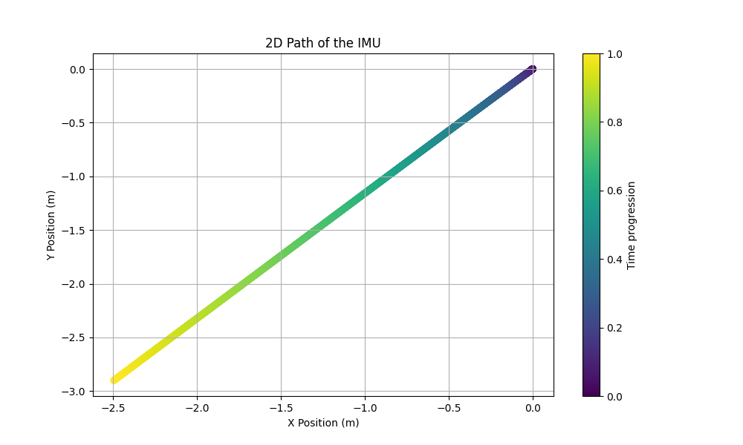
Absolute Position

Slide 14
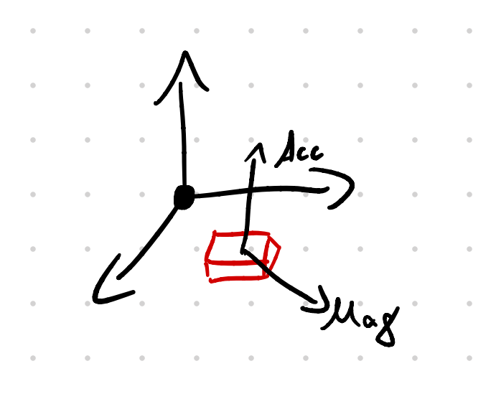

Yaw
Kalman
Filter
Output: Fused Yaw
Yaw via Mag + Accel (deg)
Yaw Rate Gyro
(deg/s)

Slide 15
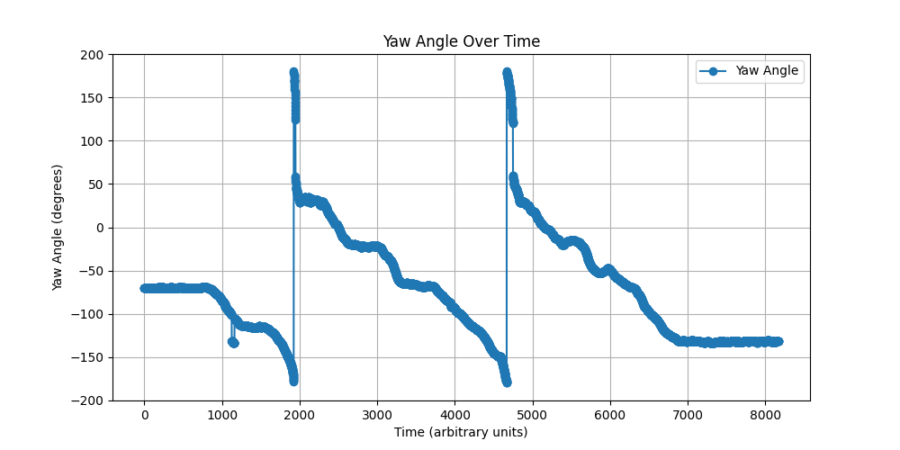
Yaw ungefiltert (Magneto + Accel)

Slide 16
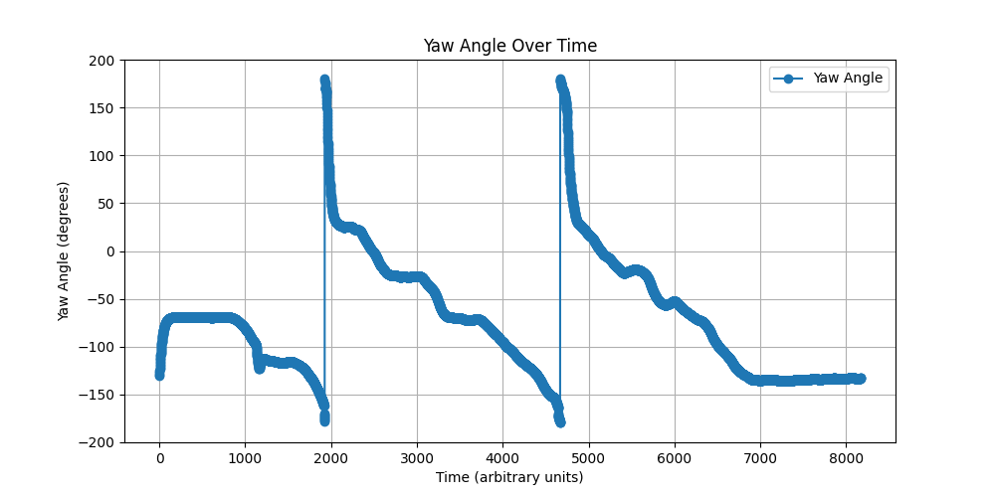
Yaw gefiltert (Magneto + Accel + Gyro)

Slide 17
Fusing Visual Odometry with IMU

Slide 18
Architecture
IMU
Complementary
Filter
Visual Odometry
Kalman Yaw
Output: Fused Yaw
Magneto +
Gyro
Rotation
Distance
Traveled
Translation direction
Position
Update
Double Integration Accel

Slide 19
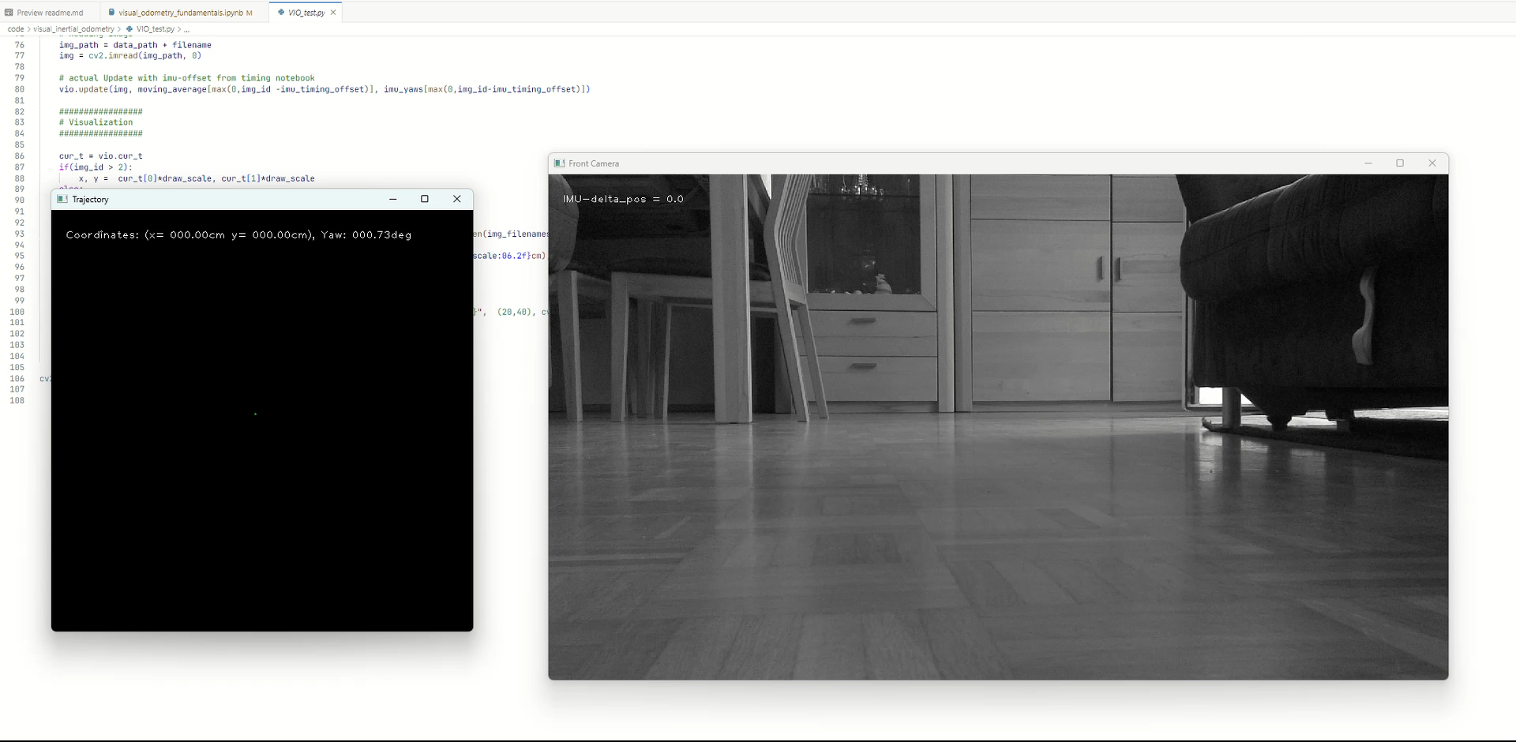
Anwendung Puzzlebot

Slide 20
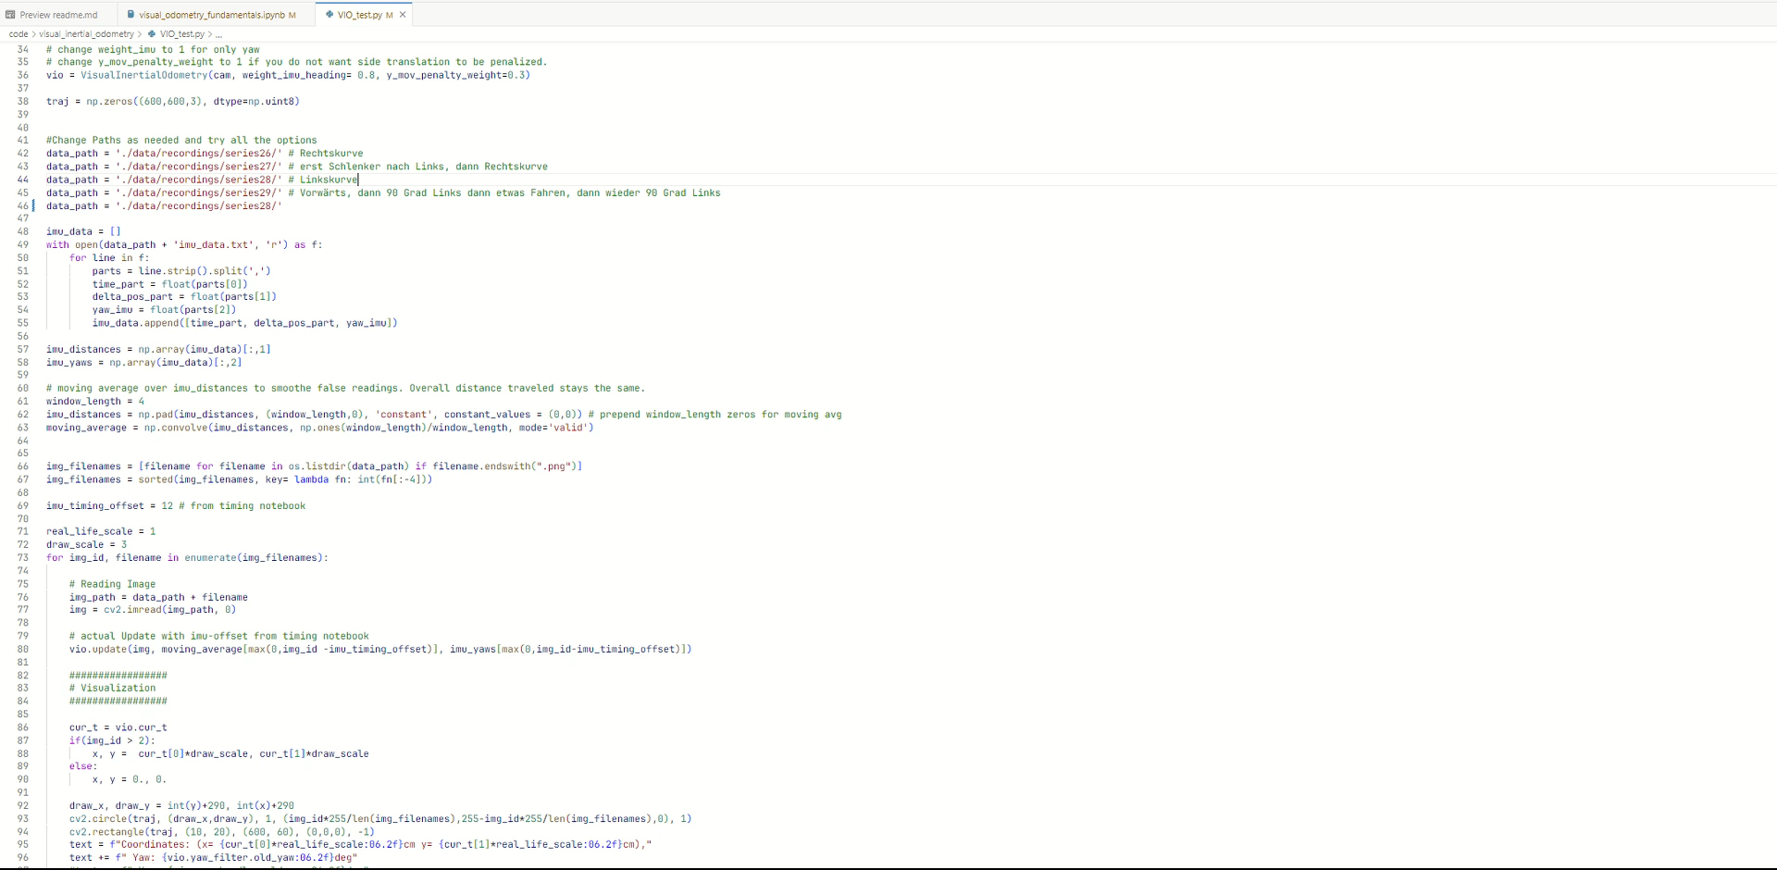
Anwendung Puzzlebot

Slide 21
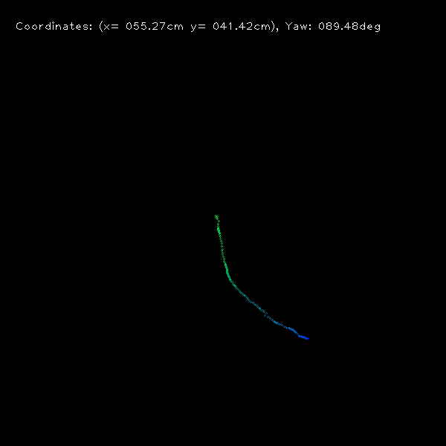
VO vs VIO

